Slide 1
Lecture 17 Amortized Analysis

Slide 2
Designing the Data-Structure
We don’t want to allocate new memory every time.
Idea: when allocating new memory, allocate a larger space.
Init()
capacity = 1
length = 0
allocate an array a[] of 1 element
Add(x)
IF length < capacity THEN
a[length] = x
length = length+1
ELSE
capacity = capacity * 2
allocate a new array a[] of capacity elements
copy the current array to the new array
a[length] = x
length = length+1

Slide 3
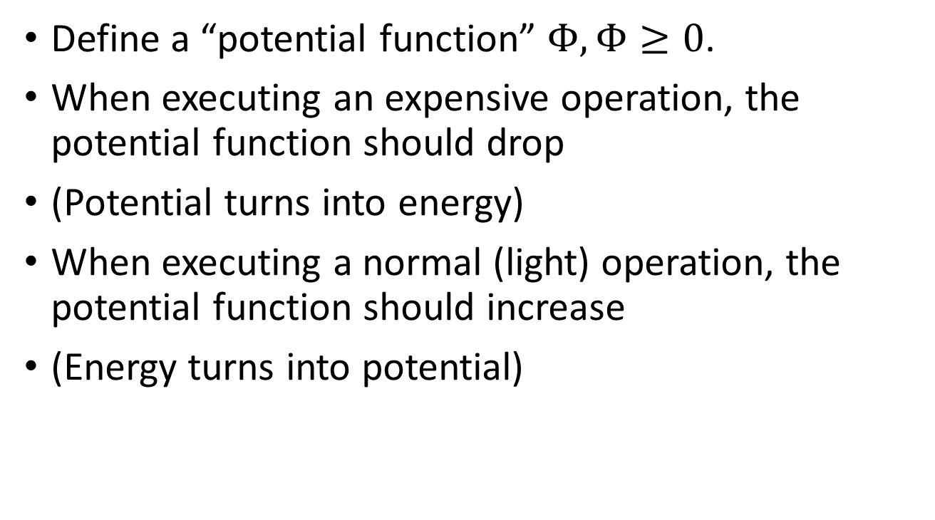
Potential Argument
Define a “potential function” $Φ,Φ≥0$.
When executing an expensive operation, the potential function should drop
(Potential turns into energy)
When executing a normal (light) operation, the potential function should increase
(Energy turns into potential)

Slide 4
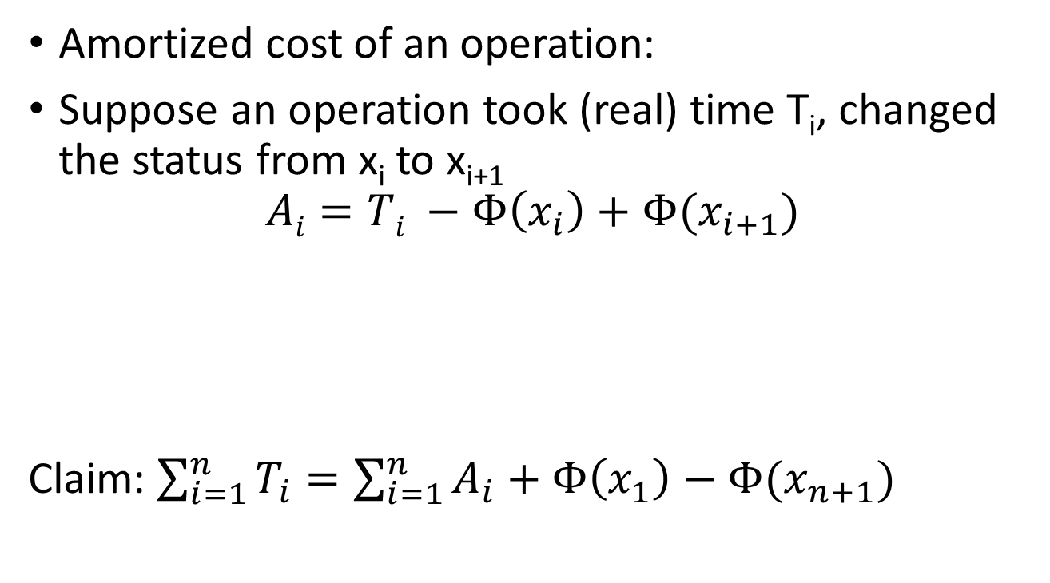
Potential Argument
Amortized cost of an operation:
Suppose an operation took (real) time T_{i}, changed the status from x_{i} to x_{i+1}
$$Ai=Ti −Φ\left(x_{i}\right)+Φ(x_{i+1})$$
Claim: $\sum_{i=1}^{n}{T_{i}}=\sum_{i=1}^{n}{A_{i}}+Φ\left(x_{1}\right)−Φ(x_{n+1})$
Amortized Cost
Real Cost
Potential Before
Potential After

Slide 5
Comparison between 3 methods
Aggregate method
Intuitive
Does not work very well if there are multiple operations (e.g. stack: push/pop; heap: insert/pop/decrease key)
Charging Method
Flexible (you can choose what operations to charge on and how much to charge)
Needs to come up with charging scheme
Potential Method
Very flexible
Potential function is not always easy to come up with.

Slide 6
Data-structure for Disjoint Sets
Problem: There are n elements, each in a separate set. Want to build a data structure that supports two operations:
Find: Given an element, find the set it is in.
(Each set is identified by a single “head” element in the set)
Merge: Given two elements, merge the sets that they are in.
Recall: Kruskal’s algorithm.

Slide 7
Naïve Implementation
Using Linked Lists
Merge: connects two linked lists, O(1)
Find: needs to find the head/tail of the list, O(length)
Using arrays
a[i]: the set that item i is in
Find: O(1)
Merge(i,j): needs to update many entries in the array, O(length)

Slide 8
Representing Sets using Trees
For each element, think of it as a node.
Each subset is a tree, and the “head” element is the root.
Find: find the root of the tree
Merge: merge two trees into a single tree.

Slide 9
Example
Sets {1, 3}, {2, 5, 6, 8}, {4}, {7}
Note: not necessarily binary trees.
1
2
4
7
3
8
6
5

Slide 10
Find Operation:
Follow pointer to the parent until reach the root.
1
2
4
7
3
8
6
5

Slide 11
Merge Operation
Make the root of one set as a child for another set
1
2
7
4
3
8
6
5

Slide 12
Running Time
Find: Depth of the tree.
Merge: First need to do two find operation, then spend O(1) to link the two trees.
In the worst-case, the tree is just a linked list
Depth = n.

Slide 13
Idea 1: Union by rank
For each root, also store a “rank”
When merging two sets, always use the set with higher rank as the new root.
If two sets have the same rank, increase the rank of the new root after merging.
1
1
1
4
4
3
3
7

Slide 14
Idea 2: Path compression.
After a find operation, connect everything along the way directly to the root.
2
2
6
8
6
7
8
Find(7)
3
5
3
5
4
7
4
1
1

Slide 15
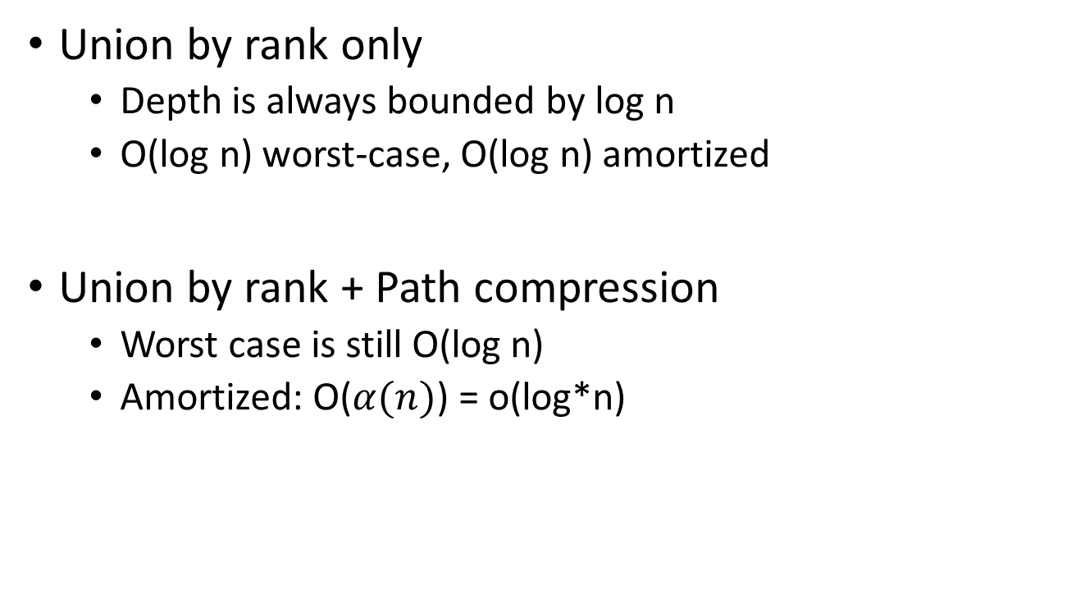
Running Time
Union by rank only
Depth is always bounded by log n
O(log n) worst-case, O(log n) amortized
Union by rank + Path compression
Worst case is still O(log n)
Amortized: O($α(n)$) = o(log*n)

